Slide 1
Contract Template Configuration
June, 2013

Slide 2
Agenda
This presentation will:
  Outline the Contract Template breakdown process
    Most of this should already have been done during the Clause Template breakdown: a Contract Template is primarily a collection of Clause Templates.
  Provide Contract Template optimization tips

Slide 3
Contract Templates
Clause Library
Contract Template
Contract Creation
1. ----------------------
-------------------------
-------------------------
-------------------------
-------------------------
Clause 1
Clause 2
Clause 3
E.g.
Payment Appendix
Fee Schedule
1. ------------------------
---------------------------
---------------------------
---------------------------
2. ------------------------
---------------------------
---------------------------
---------------------------
3. ------------------------
---------------------------
---------------------------
---------------------------
2. ----------------------
-------------------------
-------------------------
-------------------------
-------------------------
Virtual Document
---------------------------------------------------------------------------------------------
3. ----------------------
-------------------------
-------------------------
-------------------------
-------------------------
Terms
Track changes
Events & Notifications
Attachments
Approval Chains
Term Sheet (Summary)
Contract Lines
Notes
Activity History
On-line Search
Reporting
Etc.
4. ----------------------
-------------------------
-------------------------
-------------------------
-------------------------
Alternate
Names / Dates
Amounts / Quantities
Time Periods (Days, Months, etc.)
Payment methods
etc.
Notes:
The clauses stored in the “clause library” are the building blocks of the Contract Template. This includes standard clause language as well as any applicable alternate clauses.

Slide 4
Contract Template Breakdown
Usually, the starting point for this process is an actual Word document contract used by the customer. The task is to map that document to ECM constructs.
Template Breakdown Process
  Identify Key Components of a Contract
    Terms
    Clauses (including alternate clauses)
    Formats
    Approvals – Term, Clause, Contract
    Notifications
    Folders
    Security
  Populate the Design Spreadsheets
    Term Master
    Clause Master
    Contract Master

Slide 5
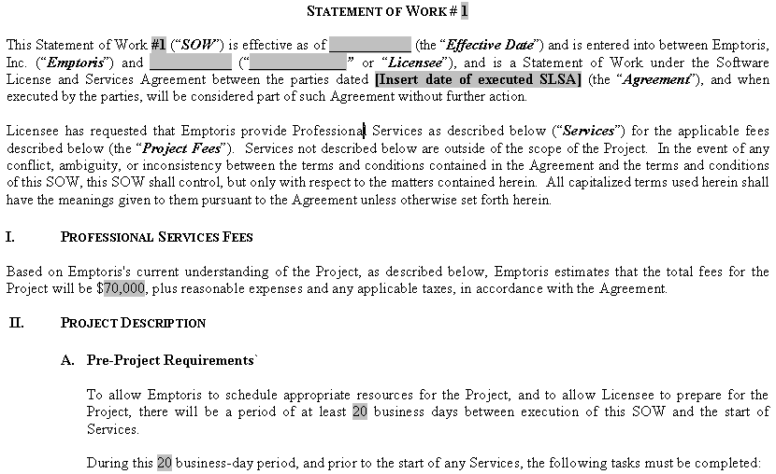
Contract Decomposition
Original Contract Breakdown

Slide 6
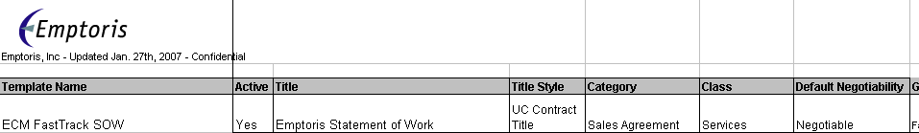
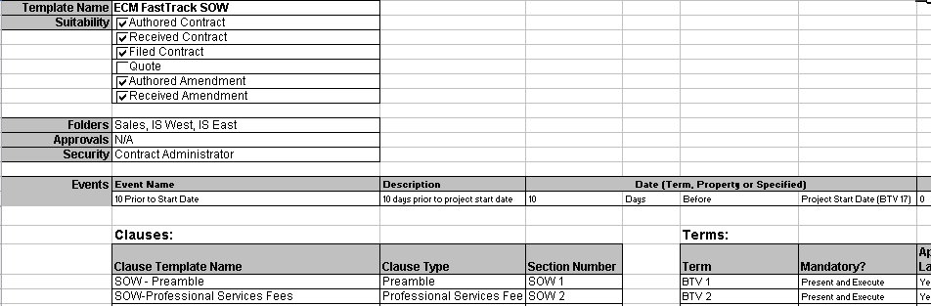
Contract Decomposition
Contract Template Attributes
Build the Contract Master Spreadsheet

Slide 7
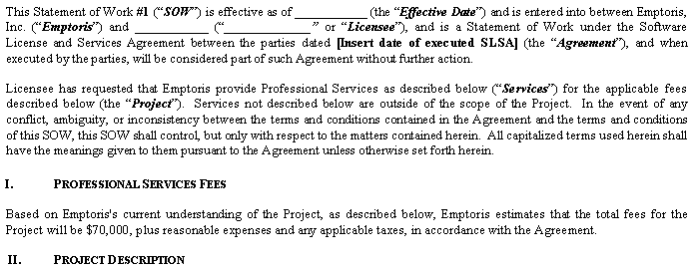
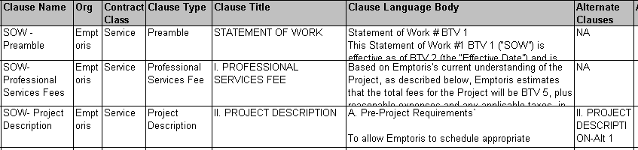
Contract Decomposition
Clause Template Breakdown
Build the Clause Master Spreadsheet

Slide 8
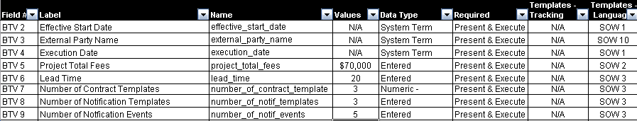
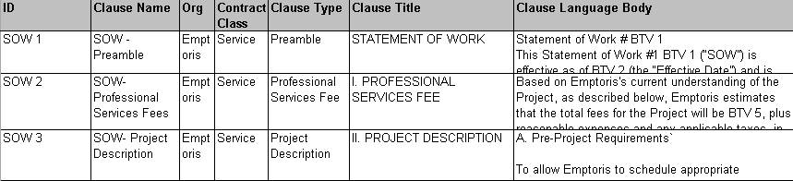
Contract Decomposition
Term Identification
Build the Term Master

Slide 9
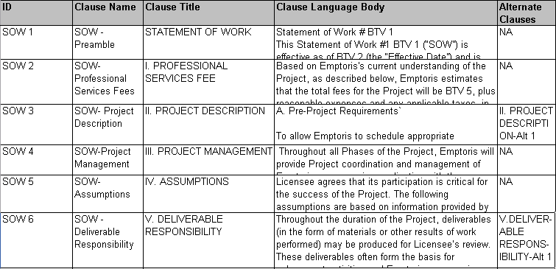
Contract Decomposition
Identify Approvals & Alternates
Define Approvals at the Clause Level
Define Alternate Clause list

Slide 10
Contract Template - Breakdown Tips
Template Consolidation
  Leverage Contract Class
  Leverage Terms, Alternate Clauses
Establish Standards
  Formatting Style
    Contract Title, Clause Title, Clause Body, Header, Footer, etc.
  Approvals: Term, Clause, Contract
  Notifications: System & Custom Events
Use Naming Conventions
Clause Rationalization
  Consolidate language
  Clause Types
Effective Use of Terms
  Leverage System Terms
  Use Custom Properties
  Use of Tracking Terms for Internal Metrics

Slide 11
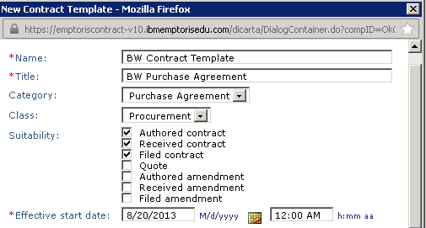
Contract Template Creation
Administration > Standards > Contract Templates > New
Complete the New Contract Template panel:
  (Most of the values here can be changed when a contract using the template is added, so further discussion is in the Standard User material about the Contract Editor Header)
  Name: must be unique
  Title: Specify Contract Title to use when this template is used in authored or received contract.
  Category: Choose one of the dropdown values (Purchase Agreement, Sales Agreement,
  Other). The value cannot be changed after template creation. When you create a contract in a given category and select a contract template, only templates having the same category are
  returned by the search.
  Class: Specify an existing Class as
  appropriate to allow easy search
  and identification. These are
  managed through Administration
  > Standards > Contract Classes. A
  Class consists of nothing more than
  a name. E.g., Consulting, NDA, ...
  Suitability: Uncheck any boxes for
  unwanted usage of this template. One
  template should NOT be used for both contracts and amendments, so latter are unchecked here

Slide 12
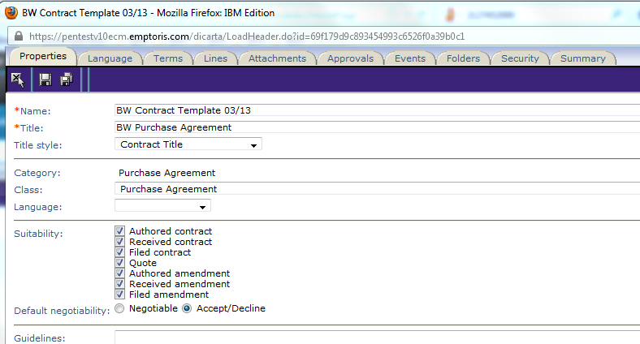
Contract Template Creation (cont.)
Complete the New Contract Template panel (continued):
  Effective Start Date: This defaults to the current date, meaning that the Template is immediately Active (eligible to be used in other objects, such as contract instances). Override this default if desired.
  Click OK.
At this point the template is opened in the Properties tab of the template editor. Several of the properties here are the same as what a user will see when adding a contract based on the template, so those are covered in the Standard User presentations. Other properties and tabs are specific to template creation and will be discussed in the next slides.

Slide 13
Contract Template: Properties tab
After clicking OK on the New Contract Template panel, the template is opened in the Properties tab of the template editor. We now look at some of the fields on this tab.
Guidelines & Notes
  Empower your users by taking advantage of these properties
  Guidelines: Are visible to the (standard) users and help them work with the contract; e.g., could say “Use this template when ...”
  Notes: Internal administrative notes; e.g., “This replaced template ABC on Jan. 1 ...”
Reference URL
  A full file path or URL can be stored in this Contract Template property to provide more information related to the template.
Organizations
  You can name multiple Organizations as search criteria for the Contract Template, and also to control access to the templates. However, when a contract instance is created, based on the template, the contract's Organization is the creator's, not one of the organizations from the contract template.

Slide 14
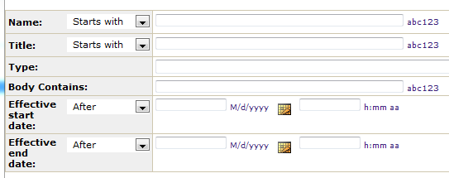
Contract Template: Add Clauses
At this point we will only work on the Language tab and add Clause Templates to the Contract Template. All of the language in an Authored contract comes from Clause Templates.
The objective here is to add clauses to the Outline box in the proper sequence, by first getting them into the “Available Clauses” box and then moving them over.
Language Tab fields (see next slide):
  Source: Leave the default of Clause Templates for now. (We will cover Line Clauses later.)
  Clause Type: A Clause Type is simply a name used for classification and search. If you know the Type of the clause template(s) you want to add, you can use the dropdown menu. When you choose the Type there, all clause templates of that type are placed in the “Available Clauses” box. Alternatively, you can use the icon to initiate a search of clauses through the following window. Selected Clauses appear in the Available box.

Slide 15
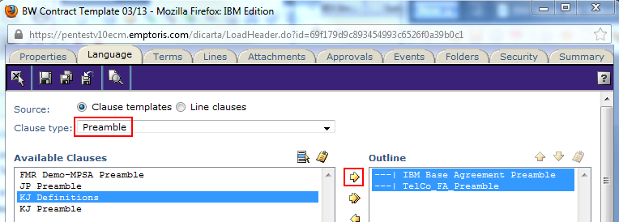
Contract Template: Add Clauses (cont.)
In the example below, we chose the Preamble type and already selected two clauses and moved them to the Outline box via the right arrow.
We have selected a third clause (KJ Definitions) and could move it to Outline, but to see its properties first, including the language body, we can click the View Properties icon:
In the Outline box, the sequence of clauses can be changed by selecting clause(s) and moving them up or down.
In the Properties area at the bottom (not shown) you can set properties of clauses in Outline, such as the Title and Body styles, and whether to start the clause on a new page, combine its title and body, or apply the header or footer from the clause to the containing contract.
After adding and positioning the desired clause templates (of all pertinent Types), save the Contract Template and close it.

Slide 16
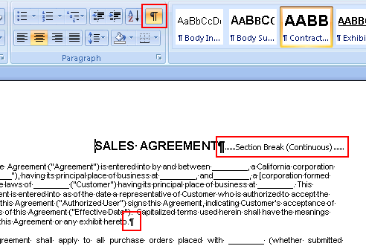
Contract Templates - Other Notes
In the Language tab of the Contract Template editor, you can use the Print Preview link - - to download a Word version of the template.
After you download the template and open it in Word,
clicking the Show/Hide Paragraph Marks at the top will
cause Section and Paragraph breaks to be visible, as in
this example. Clicking in the text will also cause the
style for that text to be highlighted in the Styles area.
Before you turn an implementation project over to a
Client, you should go through every line of every
contract template and make sure that the correct style
has been applied.
A modification scenario:
  You have a contract template that uses a particular clause template.
  You change the clause template by adding a new term.
  If you then look at the contract template, you will see the new term on the Terms tab.
  Any existing contract instances based on the contract template will not have changed.
  Any new contracts will see the term.
Contract Templates and other configuration objects do not have any tracking or audit trail, just records of Creation Date and (last) Modification Date, plus the user that performed each.
In th

Slide 17
Demonstration: Contract Templates
Follow along ….
Use BUM or Admin user; Administration > Standards > Contract Templates
Start by listing (searching for) all existing Contract Templates
Open one, such as Antigone_Sales_Contract
Focus on the Properties, Language, and Terms tabs for now

Slide 18

Questions?

